Slide 1

INF 112
OBLIG 3
GROUP 6

Slide 2





TEAM MEMBERS
AND ROLES
Who we are and how we worked
Sverre – Test manager
Loc - Graphics
Benjamin – Coder
Eirik – Code
Stian – Meeting lead, AI and Version control
Vegard – documentation manager
Robin E – Test manager
Robin G – GUI
1
of
6

Slide 3
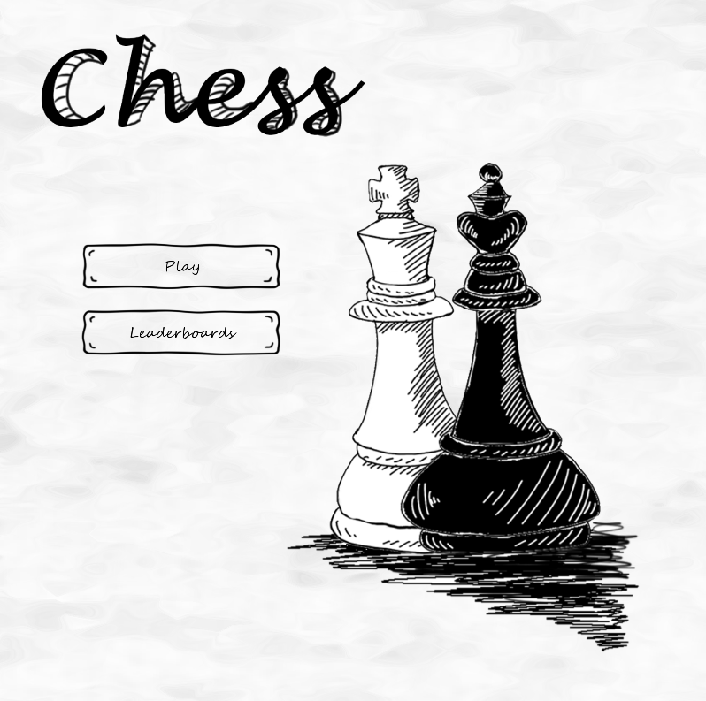
THE
GAME
2
of
6

Slide 4
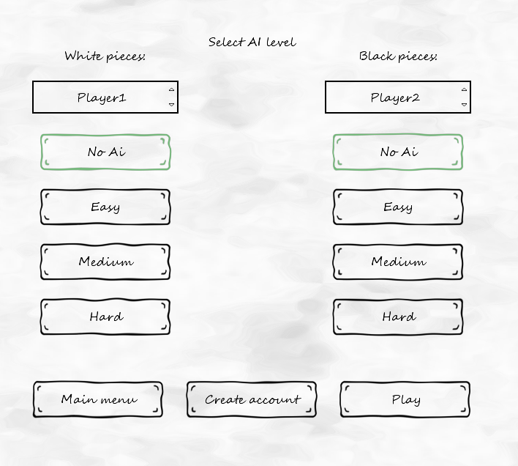
3
of
6

Slide 5
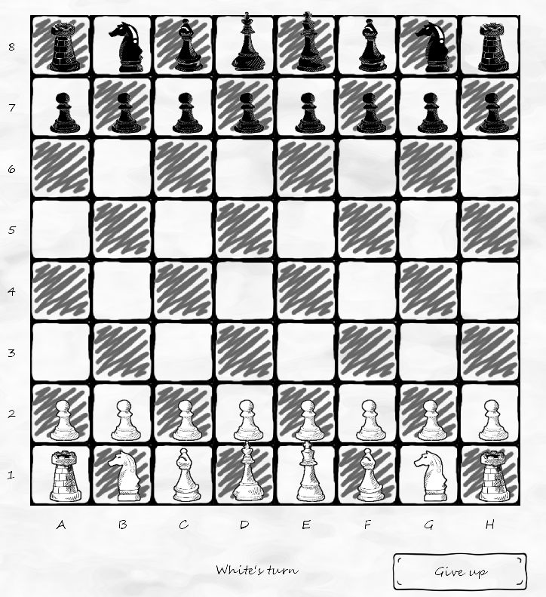
5
of
8

Slide 6
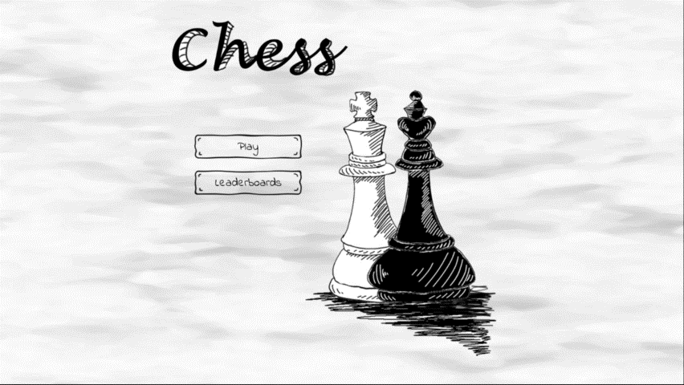
6
of
9

Slide 7
PROCESS
AND TOOLS
HOW WE WORKED
Scrum
Gitlab
Maven
JUnit
JavaDoc
LibGDX
7
of
9

Slide 8
Retrospective
SUMMARY
Results of this project
Fast start, good team spirit
Good role distribution
We have chosen tools for later iterations
We have a good project plan
All deliverables are done
In retrospect...
In conclusion:
Minutes “meeting review” section
Recurring issue: focus
Meeting discussion transition:
wide → narrow
Deliverables: abstract → concrete
Need to improve issue tracking and commit tagging with GitLab
Took on a lot of work by making our own renderer and AI
Our process has changed as we have learned from our experience
We made a chess game.
8
of
8

Slide 9
THANK YOU

